Slide 1
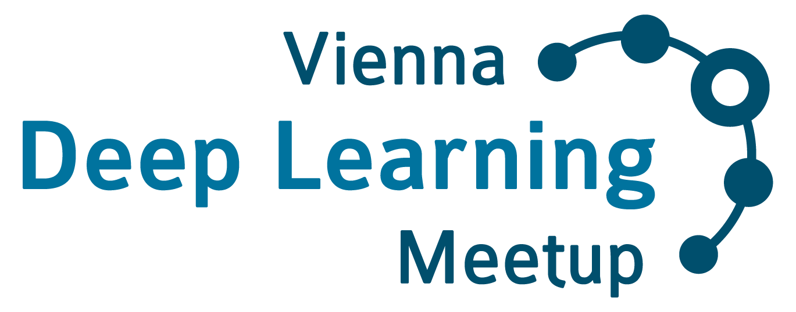
Vienna’s largest monthly event on Deep Learning & AI
www.meetup.com/Vienna-Deep-Learning-Meetup

Slide 2




The Organizers:
Thomas Lidy
Musimap
Alex Schindler
AIT & TU Wien
René Donner
contextflow
Jan Schlüter
OFAI & UTLN
www.meetup.com/Vienna-Deep-Learning-Meetup

Slide 3

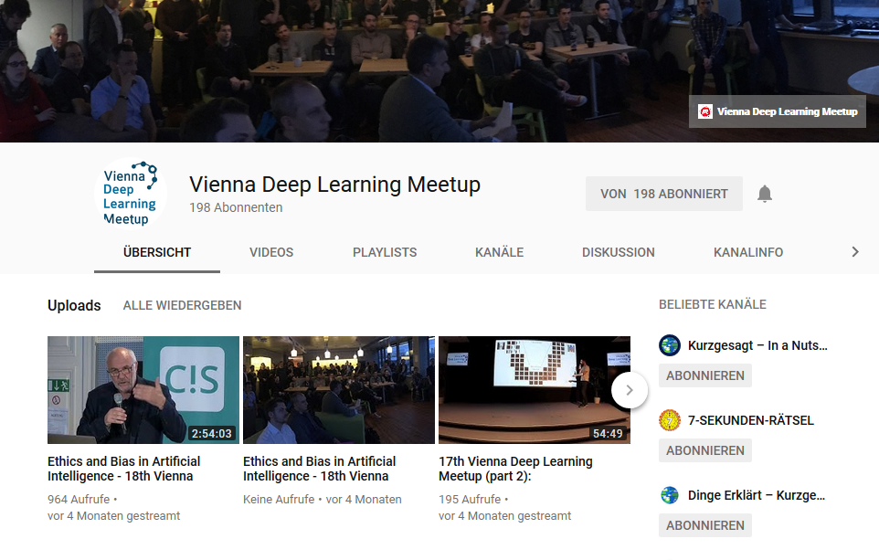
VDLM Youtube Channel
www.youtube.com/ViennaDeepLearningMeetup

Slide 4
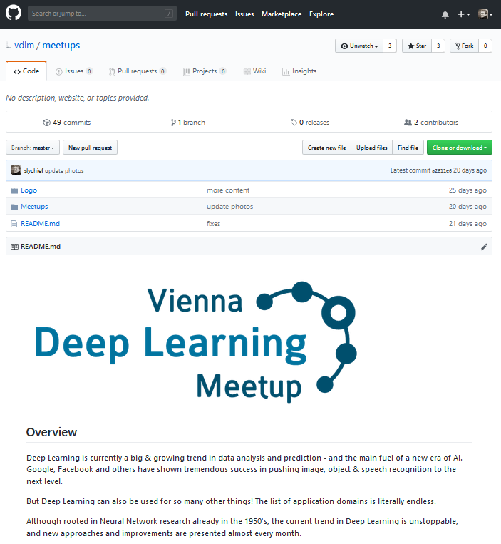
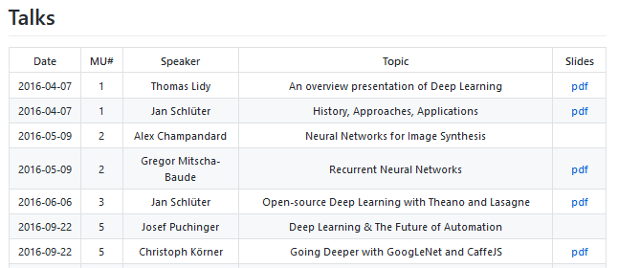
VDLM on Github
Talks
Slides
Videos
Wiki with beginner’s resources
github.com/vdlm/meetups

Slide 5
www.meetup.com/Vienna-Deep-Learning-Meetup

Slide 6


Bias in Natural Language Processing
WeAreDevelopers AI Congress Vienna
December 2018
Navid Rekabsaz
Idiap Research Institute
www.navid-rekabsaz.com
@navidrekabsaz

Slide 7
Agenda
Episode 1
Deep Learning and Challenges
Episode 2
Word Embedding — word2vec Algorithm
Episode 3
Gender Bias Quantification in Word Embedding

Slide 8
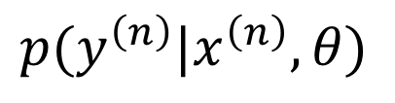
What We Talk About When We Talk About Deep Learning
Neural Networks are non-linear functions with many parameters
Usually trained to maximize likelihood
Generally optimized using variants of Stochastic Gradient Descent (SGD)
$$p(y^{\left(n\right)}|x^{\left(n\right)},θ)$$
Adopted from http://mlss.tuebingen.mpg.de/2017/speaker_slides/Zoubin1.pdf

Slide 9
What We Talk About When We Talk About Deep Learning
Deep Learning models the overall function as a composition of functions (layers)
With several algorithmic and architectural innovations (dropout, LSTM, ConvNet, Attention, GANs)
Backed by large datasets, large-scale computational resources, and enthusiasm from academia and industry!
Adopted from http://mlss.tuebingen.mpg.de/2017/speaker_slides/Zoubin1.pdf

Slide 10
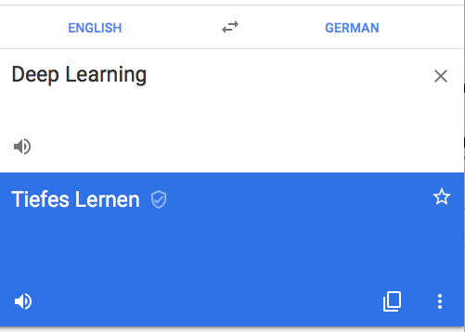

Language and Speech Processing
Machine Translation, search engines, dialog systems
Computer Vision
Face recognition, object and handwriting detection
Information Systems
Personalized recommendation systems, search engines
Self-driving cars
Scientific Data Analysis
Medicine, Astronomy, Energy
Financial Prediction
Adopted from http://mlss.tuebingen.mpg.de/2017/speaker_slides/Zoubin1.pdf

Slide 11
Beyond Deep Learning
Safety, Security and adversarial attacks
Uncertainty
What we know that we don’t know
Interpretability
Bias
Data
End user, annotator
Algorithm
Fairness and transparency
Data and model ownership
AI Democratization
Resource consumption
…
https://blog.openai.com/adversarial-example-research/

Slide 12
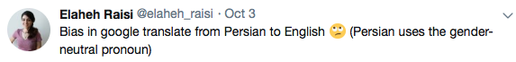
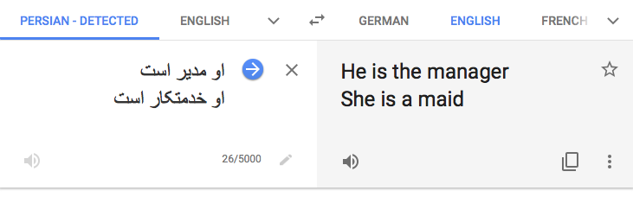
Bias in Machine Translation
same gender-neutral pronoun

Slide 13
Decomposing a Neural Network Architecture
A “basic” neural machine translation architecture
word embedding
word embedding
Word Embedding is a crucial building block of (almost) every neural NLP system

Slide 14

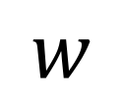
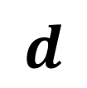
Word Embedding
Representing each word with a vector with d dimensions
Dimensions reflect the concepts in language
$$d$$
$$w$$
 |  |  | $$…$$

Slide 15
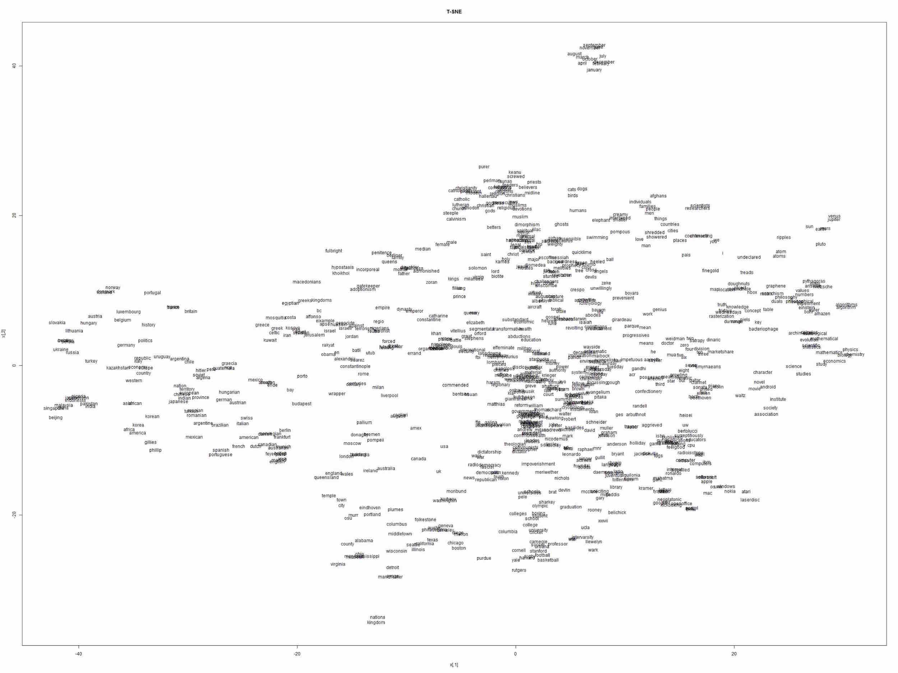
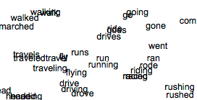
Word embedding projected in two-dimensional space

Slide 16
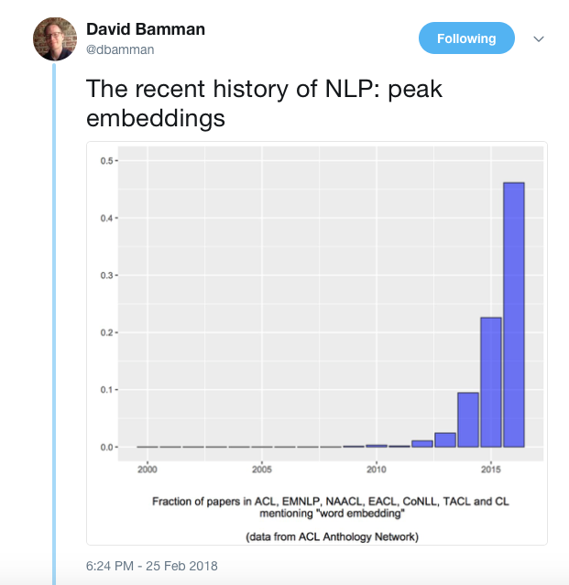

Slide 17



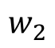
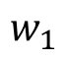
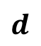
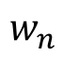
Learning Word Embedding
$$d$$
$$w_{1}$$
$$w_{2}$$
Word Embedding Black-box
$$w_{n}$$

Slide 18
word2vec
A neural word embedding algorithm

Slide 19
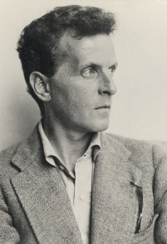
Intuition for Computational Linguistics
“In most cases, the meaning of a word is its use.”
Ludwig Wittgenstein,
Philosophical Investigations (1953)

Slide 20
Intuition for Computational Linguistics
“You shall know a word by the company it keeps!”
J. R. Firth, A synopsis of linguistic theory 1930–1955 (1957)

Slide 21
drink
sacred
alcoholic
Tesgüino
beverage
out of corn
fermented
bottle
Mexico
Nida[1975]

Slide 22
Bavaria
bottle
bitter
Oktoberfest
Märzen
brew
lager
bar
drink
alcoholic

Slide 23
Tesgüino ←→ Märzen
Algorithmic intuition:
Two words are related when they share many context words

Slide 24
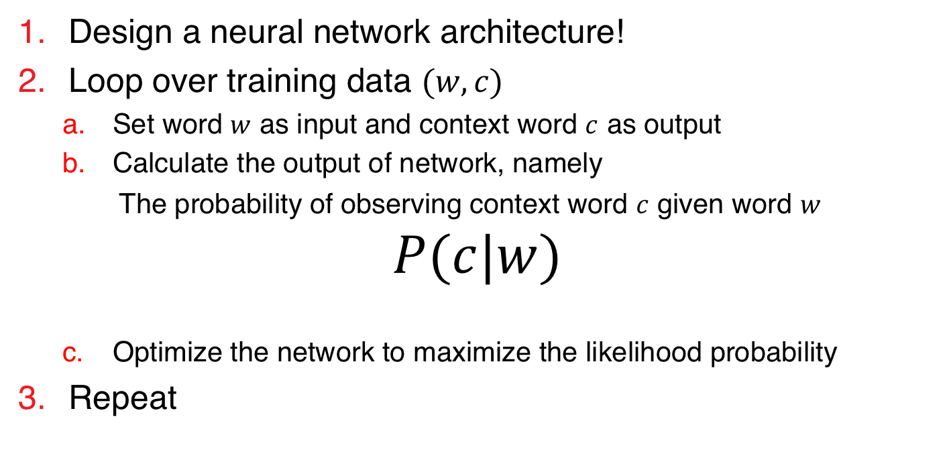
Word Embedding with Neural Networks
Recipe for creating word embedding with neural networks
Design a neural network architecture!
Loop over training data $(w,c)$
Set word $w$ as input and context word $c$ as output
Calculate the output of network, namely
The probability of observing context word $c$ given word $w$
$$P(c|w)$$
Optimize the network to maximize the likelihood probability
Repeat
No panic!!! Figuers come next!

Slide 25
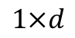
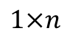
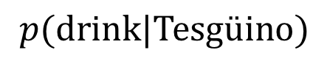
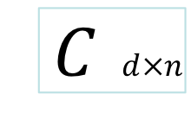
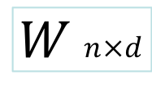
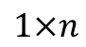
Neural Word Embedding Architecture
Train sample: (Tesgüino, drink)
Input Layer
(One-hot encoder)
Output Layer
(Softmax)
Forward pass
$$p(drink|Tesgüino)$$
Backpropagation
$$W n×d$$
$C$ $d×n$
$$1×d$$
$$1×n$$
Linear activation
$$1×n$$
Words matrix
Context Words matrix
https://web.stanford.edu/~jurafsky/slp3/

Slide 26
Märzen
Tesgüino
Word vector

Slide 27
Märzen
Tesgüino
Word vector

Slide 28
Märzen
Tesgüino
Word vector
Context vector

Slide 29
drink
Märzen
Tesgüino
Word vector
Context vector

Slide 30
drink
Märzen
Tesgüino
Word vector
Context vector

Slide 31
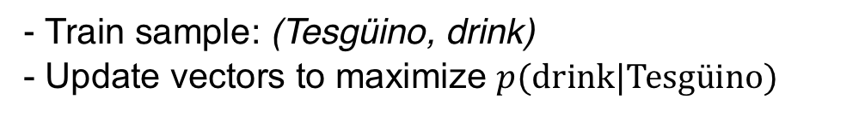
drink
Märzen
Tesgüino
- Train sample: (Tesgüino, drink)
- Update vectors to maximize $p(drink|Tesgüino)$
Word vector
Context vector

Slide 32
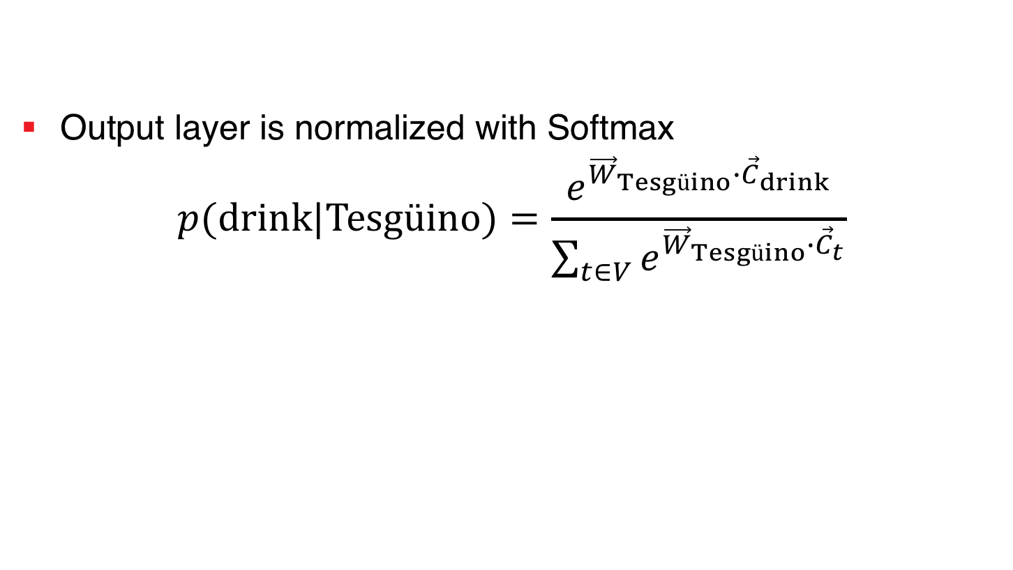
Neural Word Embedding - Summary
Output layer is normalized with Softmax
$$p(drink|Tesgüino)=\frac{e^{{\vec{W}}_{Tesgüino}∙{\vec{C}}_{drink}}}{\sum_{t∈V}{e^{{\vec{W}}_{Tesgüino}∙{\vec{C}}_{t}}}}$$
Normalization is too expensive!

Slide 33
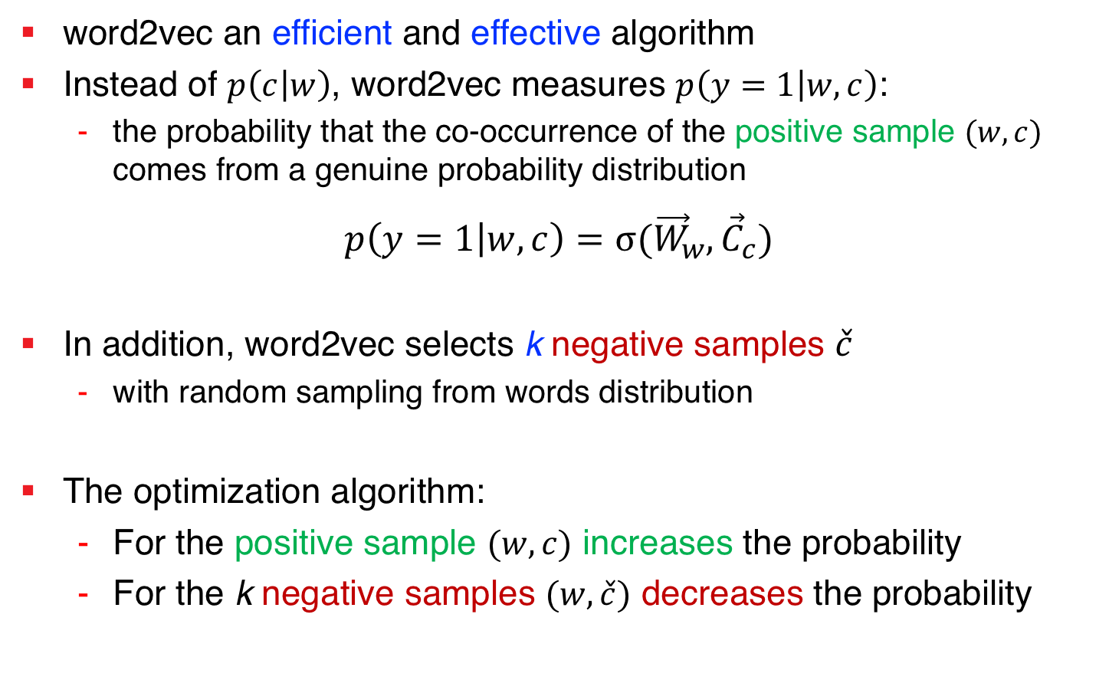
word2vec (SkipGram) with Negative Sampling
word2vec an efficient and effective algorithm
Instead of $p\left(c | w\right)$, word2vec measures $p\left(y=1 | w,c\right)$:
the probability that the co-occurrence of the positive sample $(w,c)$ comes from a genuine probability distribution
$$p\left(y=1 | w,c\right)=σ{({\vec{W}}_{w},{\vec{C}}_{c})}$$
In addition, word2vec selects k negative samples $\check{c}$
with random sampling from words distribution
The optimization algorithm:
For the positive sample $(w,c)$ increases the probability
For the k negative samples $(w,\check{c})$ decreases the probability
sigmoid

Slide 34
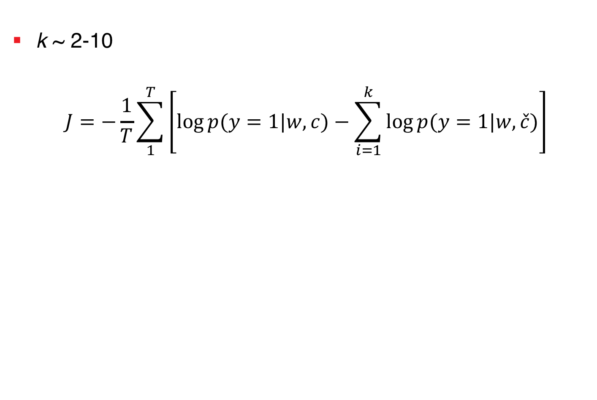
word2vec with Negative Sampling – Objective Function
k ~ 2-10
$$J=−\frac{1}{T}\sum_{1}^{T}{\left[\log{p(y=1|w,c)}−\sum_{i=1}^{k}{\log{p(y=1|w,\check{c})}}\right]}$$
Training Samples
Negative Samples

Slide 35
drink
Tesgüino
Train sample: (Tesgüino, drink)
Word vector
Context vector

Slide 36
drink
Tesgüino
Train sample: (Tesgüino, drink)
Sample k negative context words
Word vector
Context vector

Slide 37
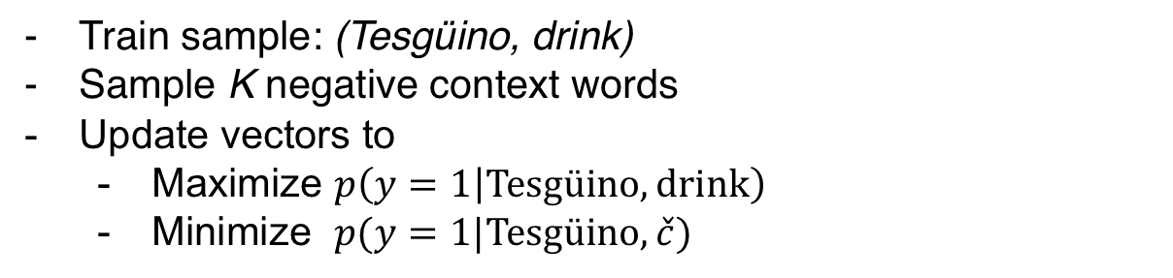
drink
Tesgüino
Train sample: (Tesgüino, drink)
Sample K negative context words
Update vectors to
Maximize $p\left(y=1 | Tesgüino,drink\right)$
Minimize $p(y=1|Tesgüino,\check{c})$
Word vector
Context vector

Slide 38
Gender Bias Quantification
encoded in word embedding

Slide 39
she
Nurse
Manager
he
Housekeeper
Word vector
Context vector

Slide 40
she
Nurse
Housekeeper
Manager
he
Word vector
Context vector

Slide 41
Gender Bias in Wikipedia
The bias of 350 occupations to female/male in the word2vec model, created on English Wikipedia

Slide 42
Conclusion
Episode 1
Challenges in Deep Learning
Data bias in NLP systems
Episode 2
Semantics and word embedding
word2vec algorithm
Episode 3
Bias quantification
Showing gender bias in Wikipedia text

Slide 43
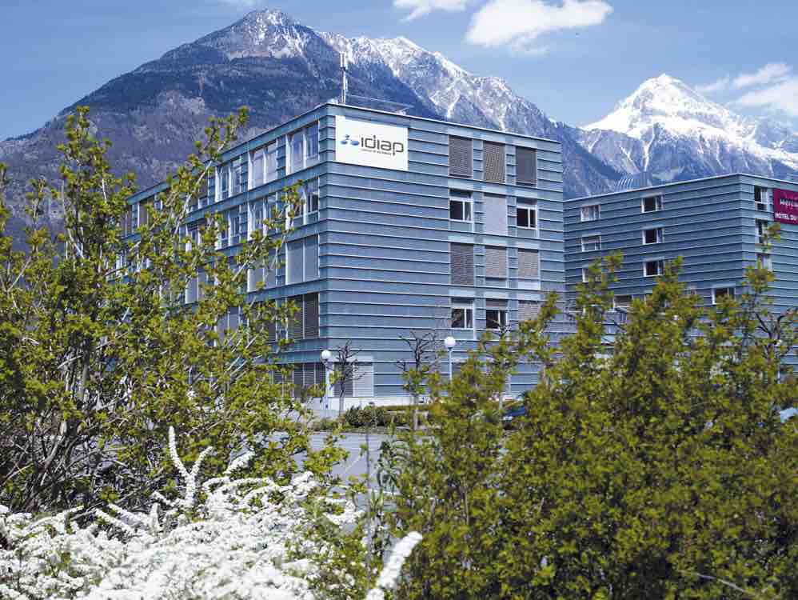
Thanks!
www.navid-rekabsaz.com
@navidrekabsaz

